Slide 1
MULTI SEASON PLANTING PROGRESS REPORT
OCTOBER 2020

Slide 2
Contents
PROJECT BACKGROUND
PROJECT DELIVERABLES
MECHANISATION BUDGET
INPUTS AND STORAGE FACILITIES
MECHANISATION MODEL CHALLENGES
RECOMMENDATIONS
OCTOBER IMPLEMENTATION PLAN

Slide 3
PROJECT BACKGROUND
The Department of Agriculture and Rural Development as a custodian of agriculture in the province has realised that food security is a great concern amongst the black impoverished communities.
An aggressive multi-season planting programme was introduced to address the issues of food security.
The department therefore provides production inputs and mechanisation to the identified beneficiaries.
SAFDA Farm Management Services (Pty) Ltd was appointed for 36 months to conduct a monitoring and evaluation of the Multi-Season Planting Programme.

Slide 4
Year 1 Deliverables
Project Set up – inception report and SLA
SLA’s with external parties
Review of Departmental policies associated with the programme
District Readiness Assessment and Risk mitigation plan
M & E Framework
Customised District Implementation Plan
Monitoring and Reporting on performance, including expenditure
Marketing Plan
Recommendations to improve efficiency and sustainability
Reports – bi-weekly, monthly , quarterly and Cabinet

Slide 5
PROJECT DELIVERABLES (targeted ha)
District | Annual target | Database Targets | Ha Varience
Amajuba | 1500 | 1490.62 | -9.38
Harry Gwala | 4000 | 3877.00 | -123.00
King Cetshwayo | 1200 | 1201.00 | 1.00
uGu | 2000 | 1582.56 | -417.44
uMgungundlovu | 1000 | 1000.28 | 0.28
uMkhanyakude | 2238 | 2353.40 | 115.40
uMzinyathi | 3050 | 3095.70 | 45.70
uThukela | 1700 | 2605.14 | 905.14
Zululand | 3500 | 3618.10 | 118.10
eThekwini | 250 | 250.00 | 0.00
iLembe | 500 | 500.00 | 0.00
Total | 20938 | 21573.80 | 635.80
Desktop Database Assessment completed
Final confirmed ha for 11 districts total 21 573.8ha
There is an increase in total targeted ha of 635.80ha, this has budgetary implications
Verification of beneficiaries must be conducted as well as GIS Co-ordinates of all the identified fields.

Slide 6
PROJECT DELIVERABLES
District | Annual Target per Database | Q1 and Q2 performance targets | Outstanding Ha (Q3 & Q4) | % OUTSTANDING ha
SERVICE PROVIDER MODEL
Amajuba | 1490.62 | 20 | 1470.62 | 99%
Harry Gwala | 3877.00 | 45 | 3832.00 | 99%
King Cetshwayo | 1201.00 | 180 | 1021.00 | 85%
uGu | 1582.56 | 590 | 992.56 | 63%
uMgungundlovu | 1000.28 | 90 | 910.28 | 91%
uMkhanyakude | 2353.40 | 423 | 1930.40 | 82%
uMzinyathi | 3095.70 | 460 | 2635.70 | 85%
uThukela | 2605.14 | 30 | 2575.14 | 99%
Zululand | 3618.10 | 30 | 3588.10 | 99%
DARD FLEET MODEL
Ethekwini | 250.00 | 50 | 200.00 | 80%
Ilembe | 500.00 | 120 | 380.00 | 76%
Total | 21573.80 | 2038.00 | 19535.80 | 91%
Province has 91% outstanding ha to be delivered for Q3 & Q4
Verify delivery targets for Q1 and Q2
Identify Land Reform and beneficiaries that can participate in the programme in order to fast track delivery

Slide 7
MECHANISATION BUDGET
Table 1: Mechanisation Activities | cost per ha
Ripping | R 1,300.00
Ploughing | R 1,300.00
Discing | R 1,000.00
Planting | R 750.00
Total cost per ha | R 4,350.00
Activity cost per ha are based on DARD rates specified on the Contractor Tender Document
Budget calculation are based on Table 1 – this excludes fertilizer application and Chemical spraying activities
Original annual budget used an average of R4000 per ha,
Table 2: Mechanisation Activities | cost per ha
Ripping | R 1,300.00
Ploughing | R 1,300.00
Discing | R 1,000.00
Planting | R 750.00
No-till Planting | R 1,550.00
Lime/ Fertiliser | R 450.00
Spraying | R 450.00
Total cost per ha | R 6,800.00

Slide 8
ANNUAL TARGETS BUDGET District | ANNUAL Database Targets | Average Cost per Ha | Total budget | Budget available | Budget shortfall
Amajuba | 1490.62 | R4,350.00 | R 6,484,197.00 | R 6,800,000.00 | R 315,803.00
Harry Gwala | 3877.00 | R4,350.00 | R16,864,950.00 | R 4,800,000.00 | -R12,064,950.00
King Cetshwayo | 1201.00 | R4,350.00 | R 5,224,350.00 | R 6,000,000.00 | R 775,650.00
uGu | 1582.56 | R4,350.00 | R 6,884,136.00 | R 9,000,000.00 | R 2,115,864.00
uMgungundlovu | 1000.28 | R4,350.00 | R 4,351,218.00 | R 9,000,000.00 | R 4,648,782.00
uMkhanyakude | 2353.40 | R4,350.00 | R10,237,290.00 | R 9,000,000.00 | -R 1,237,290.00
uMzinyathi | 3095.70 | R4,350.00 | R13,466,290.65 | R 8,000,000.00 | -R 5,466,290.65
uThukela | 2605.14 | R4,350.00 | R11,332,362.47 | R 4,000,000.00 | -R 7,332,362.47
Zululand | 3618.10 | R4,350.00 | R15,738,735.00 | R 8,952,000.00 | -R 6,786,735.00
Total | 20823.80 |  | R90,583,529.12 | R65,552,000.00 | -R25,031,529.12
DATABASE CONFIRMED TARGETS District | Database Targets Q3&Q4 | Average Cost per Ha | Total budget | Budget available | Budget shortfall
Amajuba | 1470.62 | R4,350.00 | R 6,397,197.00 | R 6,800,000.00 | R 402,803.00
Harry Gwala | 3832.00 | R4,350.00 | R16,669,200.00 | R 4,800,000.00 | -R11,869,200.00
King Cetshwayo | 1021.00 | R4,350.00 | R 4,441,350.00 | R 6,000,000.00 | R 1,558,650.00
uGu | 992.56 | R4,350.00 | R 4,317,636.00 | R 9,000,000.00 | R 4,682,364.00
uMgungundlovu | 910.28 | R4,350.00 | R 3,959,718.00 | R 9,000,000.00 | R 5,040,282.00
uMkhanyakude | 1930.40 | R4,350.00 | R 8,397,240.00 | R 9,000,000.00 | R 602,760.00
uMzinyathi | 2635.70 | R4,350.00 | R11,465,290.65 | R 8,000,000.00 | -R 3,465,290.65
uThukela | 2575.14 | R4,350.00 | R11,201,862.47 | R 4,000,000.00 | -R 7,201,862.47
Zululand | 3588.10 | R4,350.00 | R15,608,235.00 | R 8,952,000.00 | -R 6,656,235.00
Total | 18955.80 |  | R82,457,729.12 | R65,552,000.00 | -R16,905,729.12

Slide 9
MECHANISATION BUDGET
Annual targets of 20 823.80ha show a Budget shortfall of R25,031,529.12
Database confirmed targets for remaining Q3 and Q4 show a Budget shortfall of R16,905,729.12, assuming no mechanization expenditure to date
Districts need to re-confirm current available budget for the programme
The envisaged targeted ha will need to be revised and aligned to budget available

Slide 10
MECHANISATION MODEL CHALLENGES
Planting season across all districts has started (Sept- early Dec) while Service Providers have not been appointed.
Appointment of service providers might be appointed towards mid-Nov 2020, not aligned to planting season and climatic conditions. This will have an impact on overall project delivery and production yields
Service Level Agreement for management of Service providers MUST be developed to assist in mitigating some of the challenges encountered with Contractors over the years.
Purchase of adequate tractors and equipment for iLembe and eThekwini District has not been finalised.
Implementation plan and resources required for iLembe and eThekwini not in place. (maintenance plan of all equipment and machinery, supply of diesel, drivers, storage facilities and security of the fleet)

Slide 11
INPUTS STORAGE FACILITIES
DISTRICT NAME | STORAGE FACILITIES |  | INPUTS AVAILABILITY
 | Available Yes/ No | Comments | Verified with Beneficiaries | Comments
SERVICE PROVIDER MODEL
Amajuba | Yes |  | No | Majority of the inputs have been distributed to beneficiaries
Harry Gwala | Yes | Old Dept housing, old offices and car garages have been used as storage facilities. Capacity is not sufficient | No | Some have been distributed to farmers
King Cetshwayo | Yes | Old office spaces and Car garages are used. | No | Some inputs have been distributed to farmers
uGu | Yes | Old Dept housing, old offices and car garages have been used as storage facilities. Capacity is not sufficient | No | Some inputs have been distributed – verification is required.
uMgungundlovu | No | District does not have storage facilities | No | All Inputs have been distributed to farmers
uMkhanyakude | Yes |  | No | Some inputs have been distributed to farmers
uMzinyathi | Yes | Old buildings used as storage facility. Proper storage infrastructure with proper ventilations needs to be developed. | No | Some have been distributed to farmers
uThukela | Yes | Old office spaces and car garages are used. | No | Some have been distributed to farmers
Zululand | Yes | The district indicated that some inputs are stored in Pongola | No | Some have been distributed
DARD FLEET MODEL
Ethekwini | No | District does not have storage facilities | No | All have been distributed to farmers
Ilembe | No | District does not have storage facilities | No | All have been distributed to farmers

Slide 12
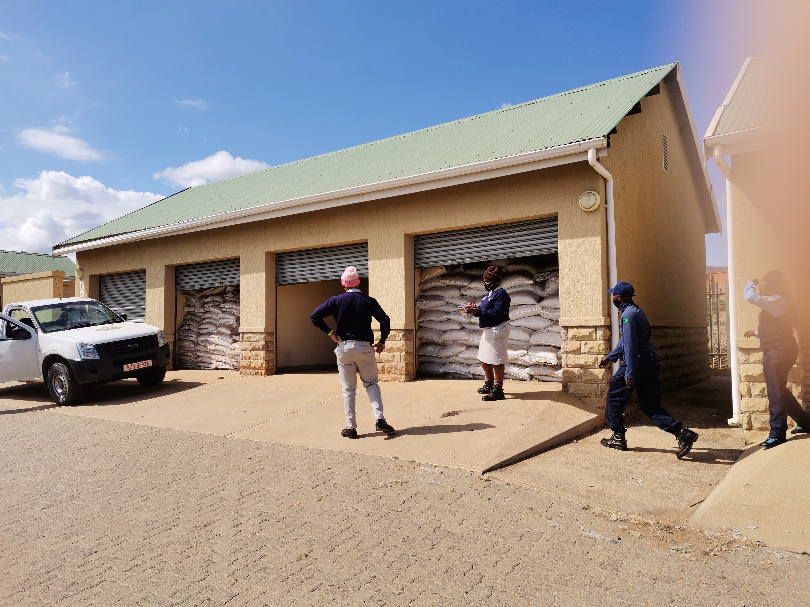
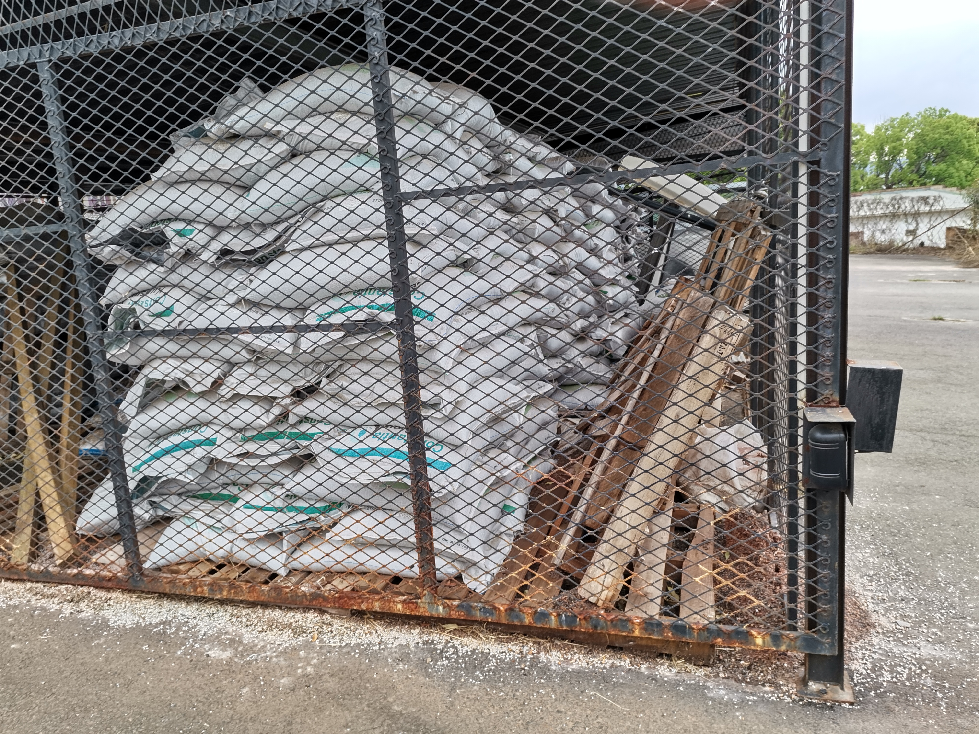
INPUTS STORAGE FACILITIES
The storage facilities can only be used for temporary storage and not long term.
Storage facilities for agricultural inputs need to meet certain standards.
Type of storage used has an impact on the quality of the product especially seeds

Slide 13
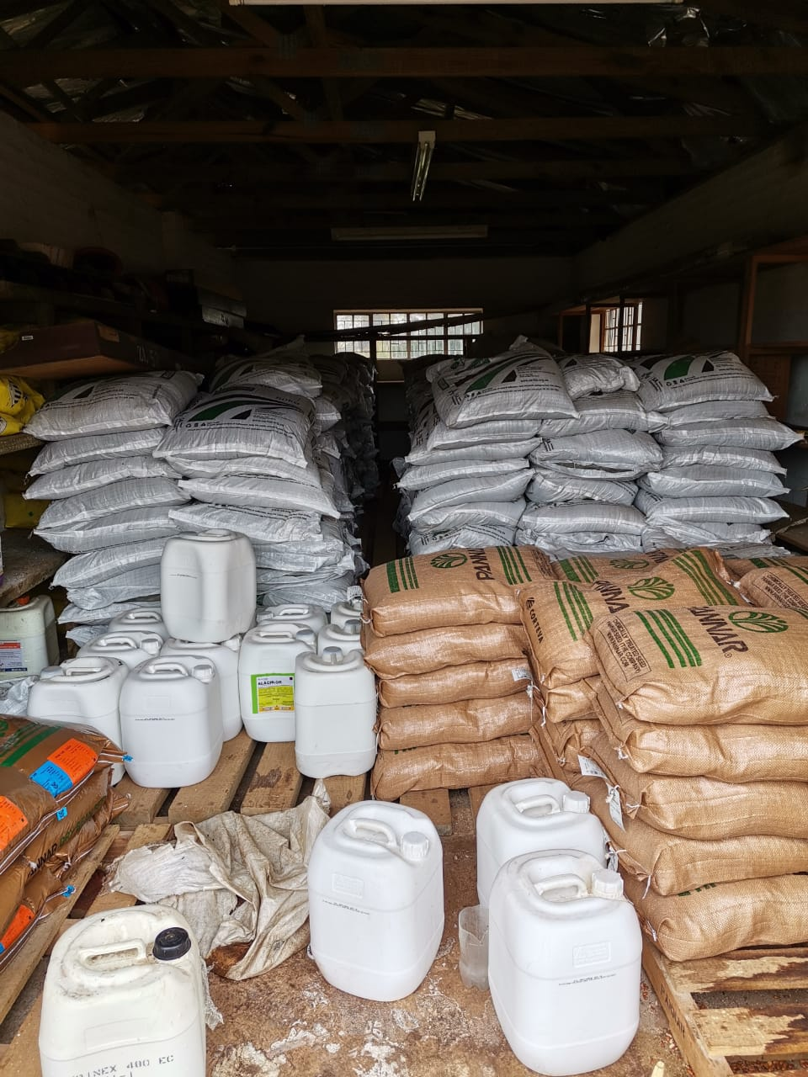
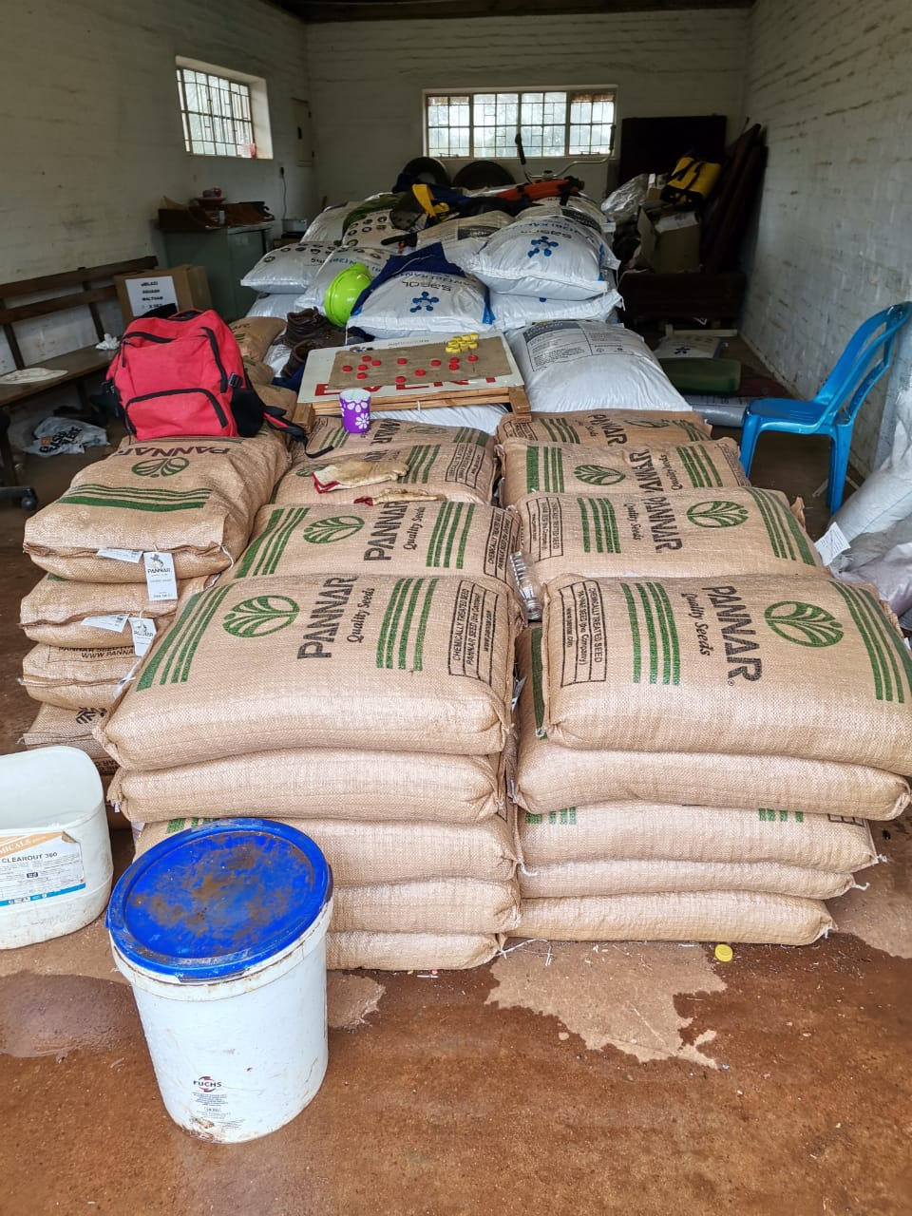
INPUTS STORAGE FACILITIES

Slide 14
RECOMMENDATIONS
RECOMMENDATION ITEMS
Inclusion of Land Reform beneficiaries onto the programme | SAFDA has developed an inclusion criterion to be shared with DARD Farmer Must have own Machinery and Equipment, this will assist to fast track delivery DARD to supply inputs to Land Reform SAFDA and DARD to identify farmers and develop new database Final draft proposal to be send to DARD WEEK 2 OCTOBER
Deviate funds to purchase production inputs | Request DARD to deviate funds committed to Mechanization for the purchase of more inputs Certain districts have distributed the inputs due to storage limitations – no guarantee if inputs are available Purchase inputs to be distributed to Land Reform Request to purchase directly from Seed and Fertiliser Suppliers (SCM processes may delay)
Deviate funds for Storage Facilities | Depts model to purchase inputs the previous year must be supported by proper facilities to avoid risks Develop guidelines for storage of all types of inputs (for noting by SCM and District Offices
DARD Contractor Readiness Assessment of Service Providers | SAFDA to assist DARD in drafting of SLA for Contractors Conduct Contractor Readiness assessment in preparation for next planting season

Slide 15
RECOMMENDATIONS
There is an urgent need to align all relevant units supporting this programme such as SCM and M&E units.
M&E unit needs to re-design its reporting structure and incorporate measuring of output and impact (discussions are taking place with M &E)
SCM needs to have more flexibility in terms of procurement of services and goods so that the programme is supported for effectiveness and sustainability
The Department needs to identify and prioritize land reform beneficiaries who have their own tractors and implements to fast track delivery.
Deviation of mechanization budget to procure more production inputs for land reform beneficiaries who have vast tracks of land to cover more hectares to be planted in order to achieve the targets.
The production inputs need to be procured in line with the planting season in order to avoid waste of production inputs
There is an urgent need to build adequate storage facilities in all districts for the safe keeping of production inputs.
The Department should avoid distribution of production inputs in advance, because there is no guarantee that farmers will keep these inputs for the next season.
The Department needs to seek for budget shortfall for Harry Gwala, uMzinyathi, Zululand, uThukela and uMkhanyakude districts for an amount of R25,031,529.12.

Slide 16
OCTOBER IMPLEMENTATION PLAN

Slide 17
Summary of activities for October
Verified list of beneficiaries
Verified list of inputs
Verification of distributed inputs
Inception report
Readiness Assessment Report
District implementation plans

Slide 18
Thank you

